Slide 1
Computer Networks and Internets
《计算机网络与因特网》课件
林坤辉

Slide 2
PART III Packet Transmission
Chapter 18 WAN Technologies and Routing
广域网技术与路由

Slide 3

18.2 Large Networks and Wide Areas大型网络和广域
A network technology is classified into one of three broad categories:
LAN: Local Area Network(局域网).
MAN: Metropolitan Area Network(城域网).
WAN: Wide Area Network(广域网).

Slide 4
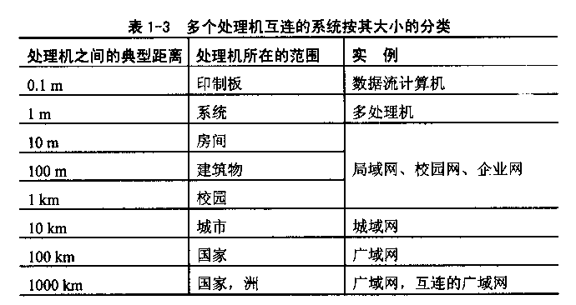

Slide 5
18.3 Packet Switches 包交换
A WAN is constructed from many switches to which individual computers connect.
The basic electronic switch used in a WAN is called a packet switch,
because it moves complete packets from one connection to another.
Each packet switch is a small computer.

Slide 6
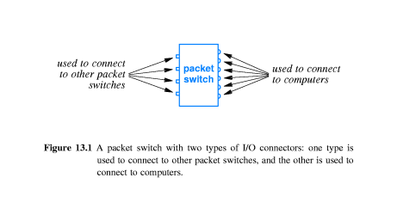
The first type of I/O device operates at high-speed, it is used to connect the switch to a digital circuit that leads.
The second type of I/O device operates at lower-speed, it is used to connect the switch to an individual computer.

Slide 7
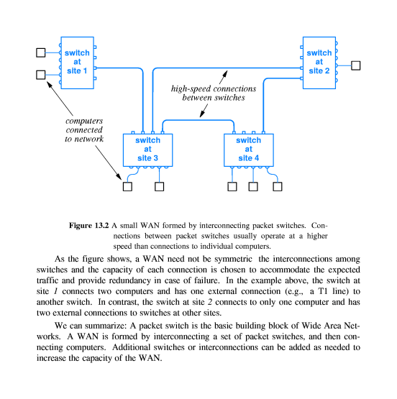
18.4 Forming A WAN广域网的构成
A set of packet switches are interconnected to form a wide Area Network.

Slide 8
18.5 Store and Forward
存储转发
A shared LAN allows only one pair of computers to exchange a frame at a given time.
A WAN permits many computers to send packets simultaneously.
Store and forward switching.

Slide 9
18.6 Physical Addressing In A WAN 广域网的物理编址
Each WAN technology defines the exact frame format a computer uses when sending and receiving data.
Each computer connected to a WAN is assigned a physical address.
Many WANs use a hierarchical addressing scheme.

Slide 10
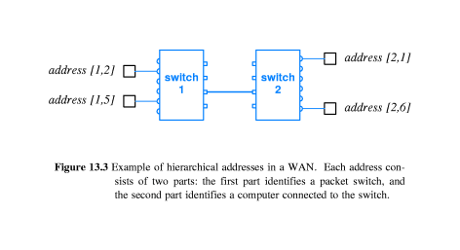

Slide 11
18.7 Next –Hop Forwarding
下一站转发
A packet switch does not keep complete information about how to reach all possible destinations.
A given switch has information about the next place(hop) to send a packet.
Next-hop information can be organized into a table.

Slide 12
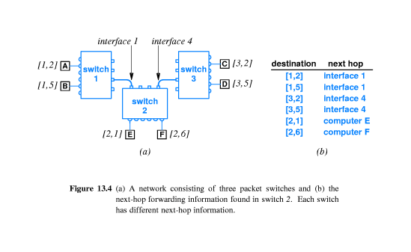

Slide 13
18.8 Source Independence
源地址独立性
The next hop to which a packet is sent depends only on the packet’s destination.
Source independence allows the forwarding mechanism in a computer network to be compact and efficient.

Slide 14
18.9 Relationship of hierarchical Addresses To Routing
层次地址与路由的关系
The table used to store next hop information is commonly called a routing table.
The process of forwarding a packet to its next hop is known as routing.
All destination addresses that have an identical first part will be forwarded to the same packet switch.

Slide 15
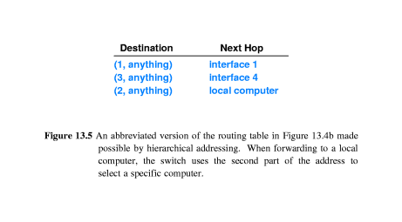
When the packet reaches the switch to which the destination computer attaches, the switch examines the second part of the address and selects the appropriate computer.

Slide 16
18.10 Routing In A WAN
广域网中的路由
Values in the routing table must guarantee following:
Universal routing: the routing table in a switch must contain a next-hop route for each possible destination.
Optimal routes: in a switch, the next-hop value in the routing table for a given destination must point to the shortest path to the destination.

Slide 17
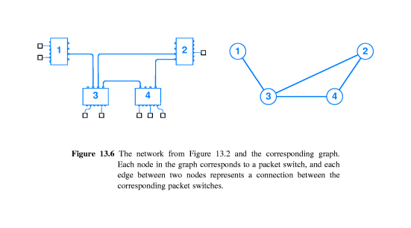
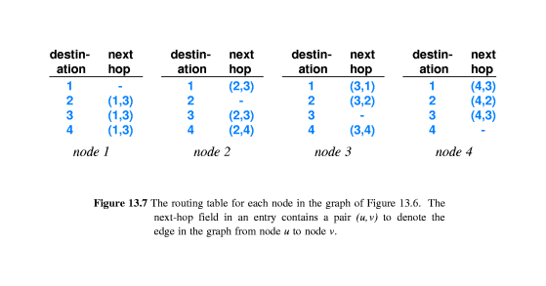

Slide 18
18.11 Use of Default Routes
缺省路由的使用
The abbreviated routing table still contains many entries with the same next hop.
Most WAN systems include a mechanism that can be used to eliminate the common case of duplication routing.

Slide 19
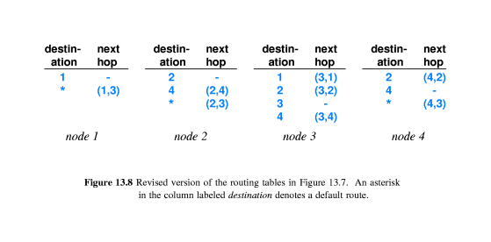
Default route or default routing table entry.
Only one default entry is allowed.
If the forwarding mechanism does not find an explicit entry for a given destination, it uses the default entry.

Slide 20
18.12 Routing Table Computation 路由表计算
There are two basic approaches:
Static routing: a program computes and installs routes when a packet switch boots; the routes do not change.
Dynamic routing: a program builds an initial routing table when a packet switch boots; the program then alters the table as conditions in the network change.

Slide 21
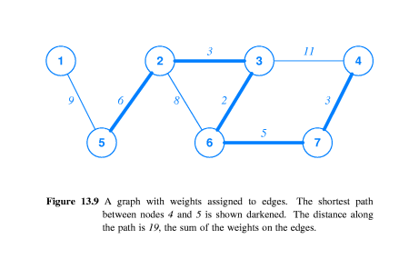
18.13 Shortest Path Computation In Graph 图中最短路径计算
By using weights on edges as a measure of distance.
A path with the fewest number of edges may not be the path with least weight.

Slide 22
18.14 Distributed Route Computation 分布式路由计算
Distributed route computation:
Each packet switch computes its routing table locally, and then sends messages across the network to neighboring pack switches to inform them of the result.
Each packet switch learns the shortest paths to all destinations.

Slide 23
18.15 Distance Vector Routing
距离矢量路由
One of the best-known algorithms for distributed route computation is the distance-vector algorithm(距离矢量算法).
A pack switch periodically sends routing information across the network to neighbors.
Each message contains pairs of ( destination, distance).

Slide 24
18.16 Link-State Routing (SPF)
链接状态路由
SPF: shortest path first.
Packet switch that use SPF send message across the network.
Each message carries the status of a link between two packet switches.
The message is broadcast to all switches.
Each switch collects incoming status messages and uses them to build a graph of the network, then the switch produce a routing table with itself as the source.

Slide 25
18.17 Example WAN Technologies
ARPANET.
公用电话交换网PSTN
公用分组交换网X.25.
Frame Relay(帧中继).
SMDS(交换多兆位数据服务 Switched Multi-megabit Data Service）
ATM异步传输模式（Asynchronous Transfer Mode）
.

Slide 26

4.1 广域网结构
  虚电路和数据报
    虚电路：面向连接，类似电话系统
    数据报：无连接，类似电报系统
  两者比较
4.2 广域网实例

Slide 27
虚电路方式
原理
  建立虚电路 －填表
  数据转发 －查表
  释放虚电路－删表
特点
  存在虚电路建立过程
  数据转发沿着同一条路径
  报文的投递可靠
  报文中不需要目的地址，只需要虚电路号
  虚电路必需进行释放

Slide 28
数据报方式
原理
  路由器为每个入站的报文单独选择一条输出线路
特点
  不需要虚电路建立过程
  路由器必须为每个输入报文单独进行路由选择
  报文投递是不可靠的
  每个报文必须包含目的地址

Slide 29
两者比较（1）
从广域网内部来看
  交换机的内存空间与线路带宽的权衡；
  虚电路建立时间和路由选择时间的比较；
  拥塞控制的难易程度；
从提供用户服务的角度来看
  “虚电路派”－“跳到跳”(hop-by-hop)控制
  “数据报派”－“端到端”(end-to-end)控制

Slide 30
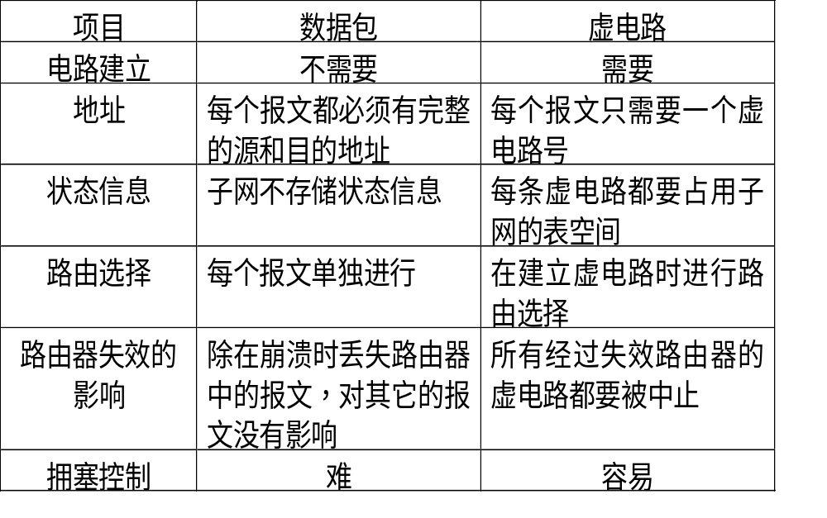
两者比较（2）

Slide 31
18.17.1 ARPA N E T
ARPA（A d v a n c e d R e s e a r c h Projects Agency美国国防部高级研究计划署）
ARPANET, the network was one of the first packet switched WANs
The network leased serial data lines connecting packet switches operated at only 56Kbps.

Slide 32
4.2.1 PSTN
功能
  是以电路交换技术为基础的用于传输模拟话音的通信网络。
组成
  本地回路——模拟线路
  干线——数字化
  电话交换机——数字化程控
数据通信
  两台计算机想通过PSTN进行通信时，必须引入Modem

Slide 33
18.17.2 X.25
C C I T T国际电话电报咨询委员会(Consultative Committee for International Telephone and Te l e g r a p h）
The standard is still known as the CCITT X.25 standard.
X.25是在70年代由CCITT制定的关于数据终端设备DTE和数据电路设备DCE之间的接口。 X.25建议：一个DTE如何连接到有关分组交换网上。X.25 建议规定了DTE与DCE之间的接口。

Slide 34
Each X.25 network consists of two or more X.25 packet switches interconnected by leased lines.
Computer connected to the packet switches can send and receive packets.
X.25 was invented before personal computers became popular.
many early X.25 networks were engineered to connect ASCII terminals to remote timesharing computers.

Slide 35
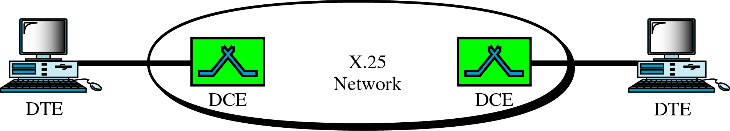
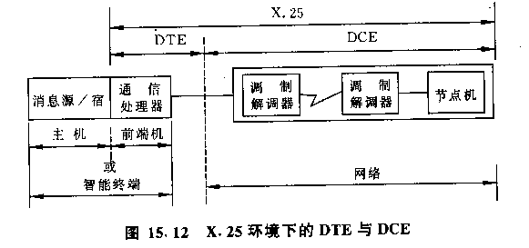

Slide 36
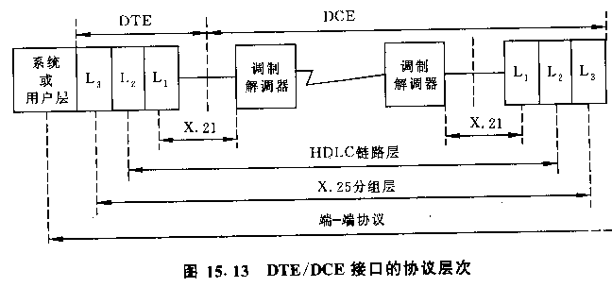

Slide 37
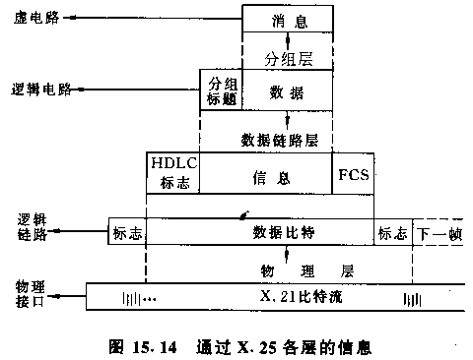

Slide 38
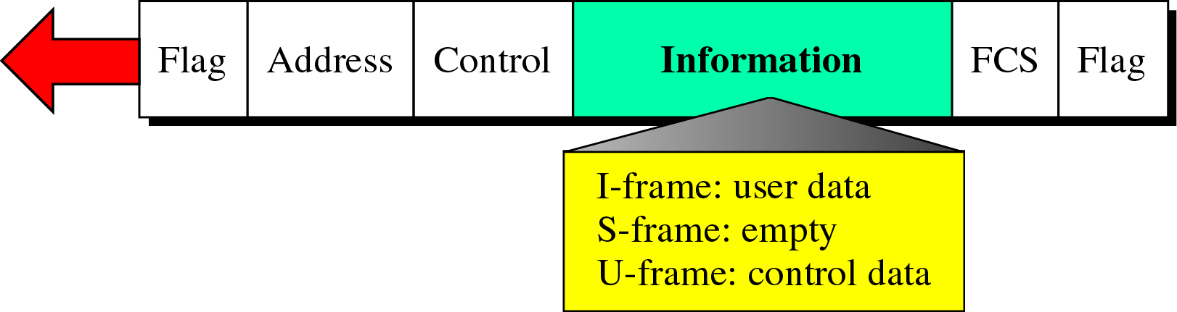
X.25帧层

Slide 39
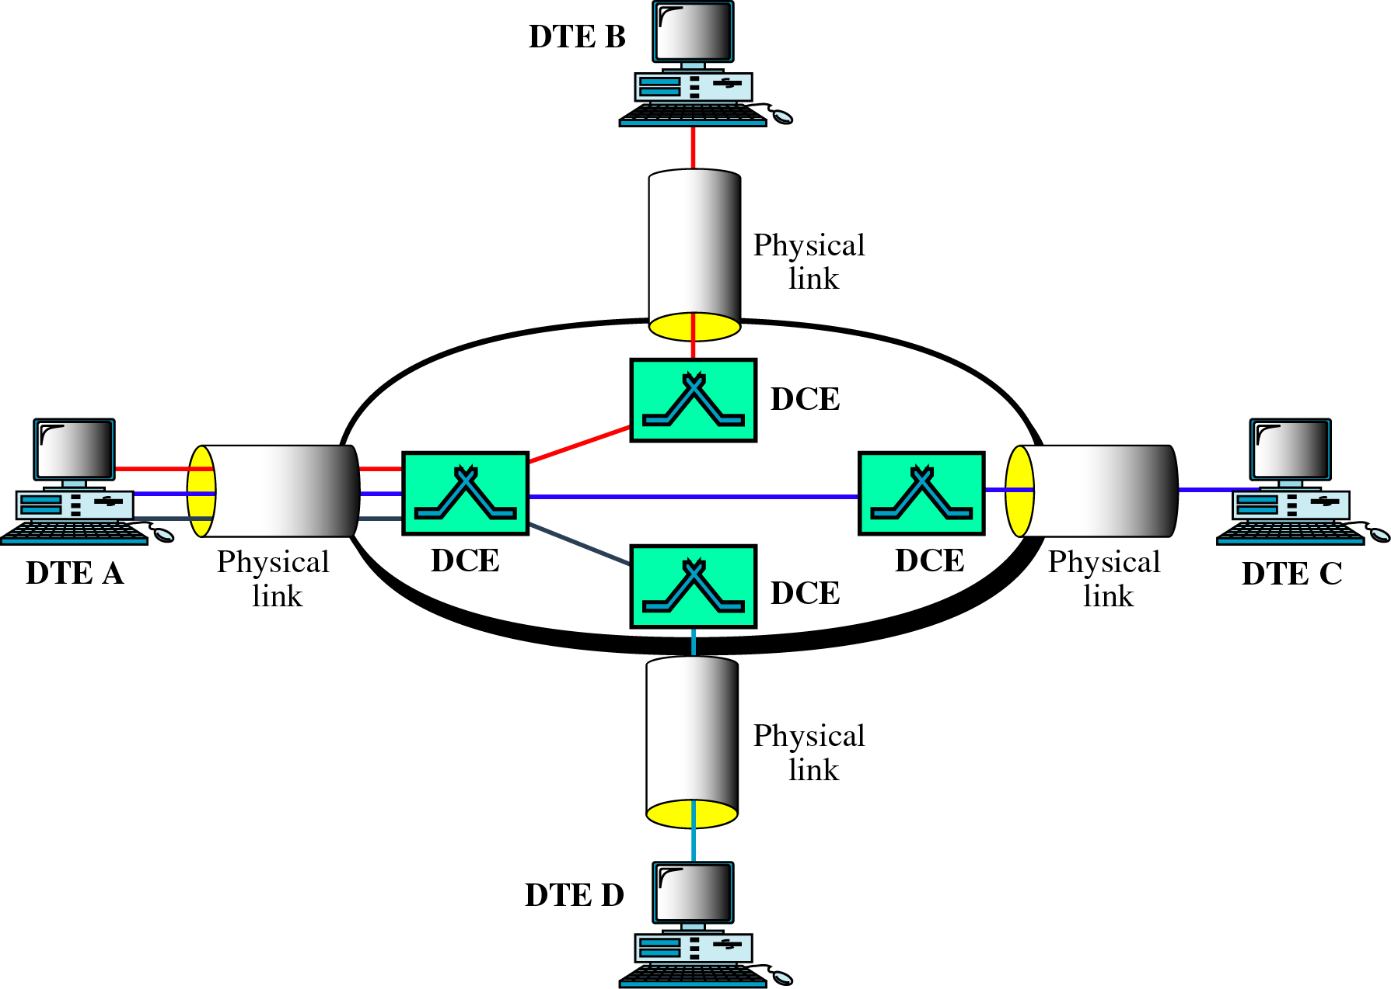
X.25虚电路

Slide 40
X.25的特点
X.25是面向连接的，它支持交换虚电路服务
  交换虚电路SVC
  永久虚电路PVC。
X.25提供差错控制
X.25提供流量控制

Slide 41
18.17.3 Frame Relay帧中继
The inventors designed Frame Relay service for use in bridging LAN segments
Frame Relay is designed to accept and deliver blocks of data
Each block can contain up to 8KB of data.
To handle data from a LAN segment, a Frame Relay connection must operate at high data rates(in practice, 1.5Mbps or 56Kbps).

Slide 42
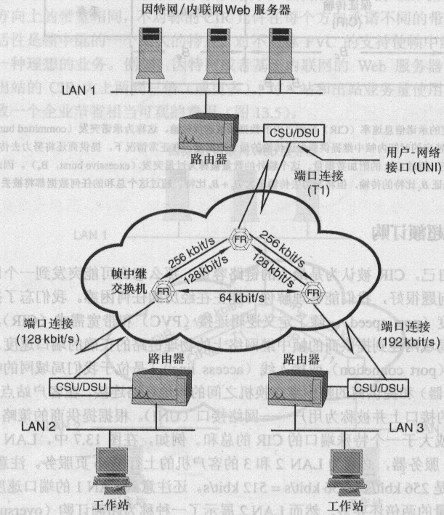

Slide 43
X.25与FR的比较（1）
X.25的背景
  传输线路：slow，analog，unreliable
  计算机：slow，expensive
  X.25协议复杂，网络保证数据传输的可靠性，而端用户对传输数据的处理相对简单
  Intelligent Network/Stupid Terminal

Slide 44
X.25与FR的比较（2）
FR的背景
  传输线路：fast，digital，reliable
  计算机：fast，inexpensive
  FR协议比较简单，但网络不保证数据传输的可靠性，端用户对传输数据的处理相对复杂
  Stupid Network/ Intelligent Terminal

Slide 45
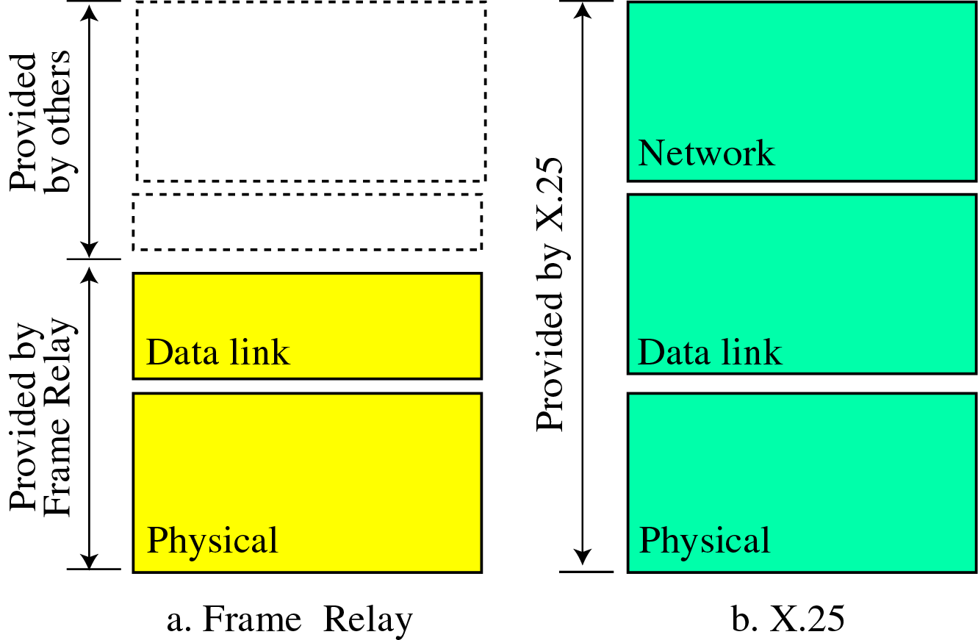
X.25与FR（2）

Slide 46
X.25与FR（2）
FR是轻型化的X.25，与X.25相比
  保留了X.25的物理层功能
  保留了X.25部分数据链路层功能，并将多路复用功能放在第二层实现
  丢弃了X.25第三层

Slide 47
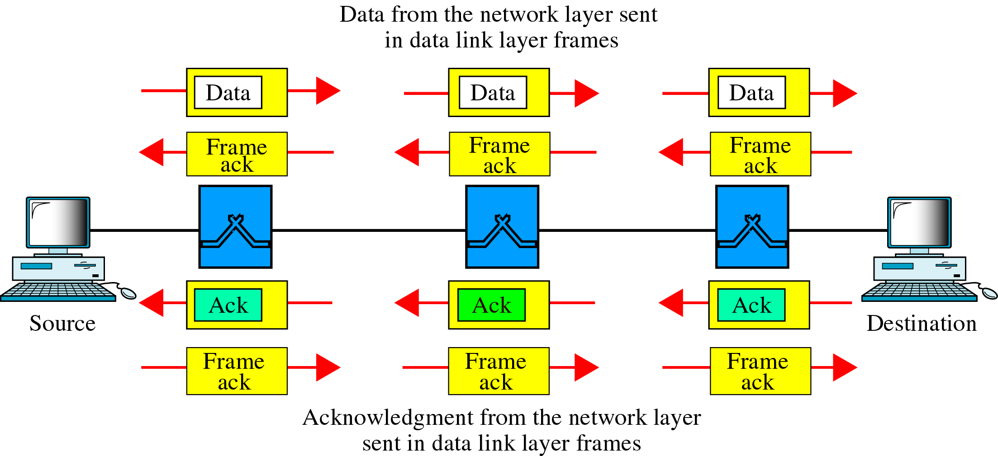
X.25的通信过程

Slide 48
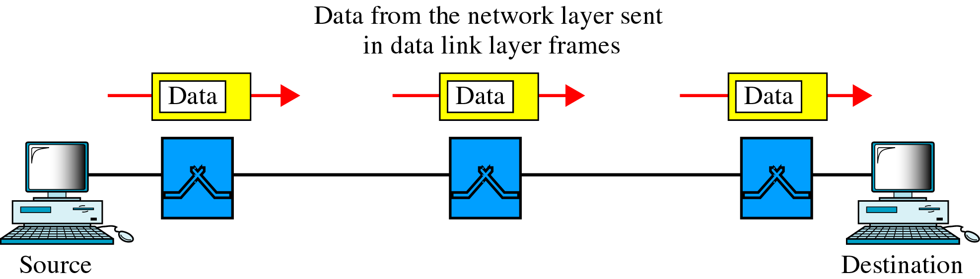
FR的通信过程

Slide 49
FR的特点
优点
  FR支持较高速率（T1或T3）
  FR只包含物理层和数据链路层，比X.25开销小
  FR允许支持突发数据，且帧长度可达9000字节
缺点
  不提供差错控制功能
  对多媒体数据传输的支持不够

Slide 50
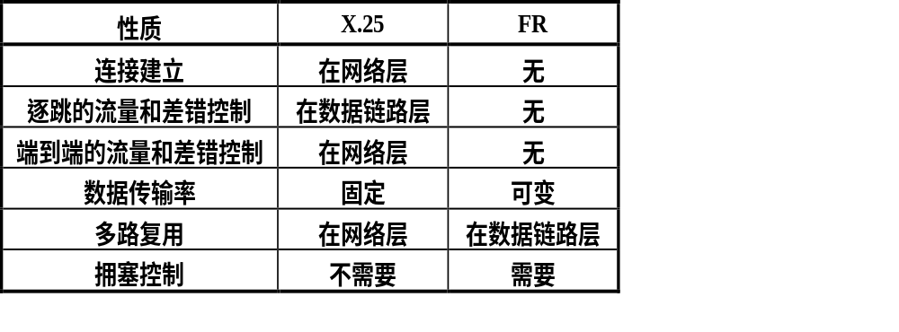
X.25与帧中继的比较

Slide 51
4.2.5 SMDS
交换式多兆位数据服务SMDS是用来连接多个局域网
SMDS的设计是针对突发数据通信的。
SMDS标准速率是45Mbps，也支持低于45Mbps的速率
SMDS提供无连接的数据传输服务

Slide 52
作业
习题：18.2，18.4
以最少跳数作为最短路径，给出下面图形中所有交换设备的路由表（格式参考图18.8）。
计算机A
计算机B
交换机1
计算机G
计算机C
交换机4
交换机2
交换机3
交换机5
计算机F
计算机H
计算机D
计算机E

